Slide 1
Lecture 14: Discriminant Analysis

Slide 2
Lecture Outline
Discriminant Analysis
LDA for one predictor
LDA for p > 1
QDA
Comparison of Classification Methods (so far)

Slide 3
Recall the Heart Data (for classification)
response variable Y
is Yes/No
Age | Sex | ChestPain | RestBP | Chol | Fbs | RestECG | MaxHR | ExAng | Oldpeak | Slope | Ca | Thal | AHD
63 | 1 | typical | 145 | 233 | 1 | 2 | 150 | 0 | 2.3 | 3 | 0.0 | fixed | No
67 | 1 | asymptomatic | 160 | 286 | 0 | 2 | 108 | 1 | 1.5 | 2 | 3.0 | normal | Yes
67 | 1 | asymptomatic | 120 | 229 | 0 | 2 | 129 | 1 | 2.6 | 2 | 2.0 | reversable | Yes
37 | 1 | nonanginal | 130 | 250 | 0 | 0 | 187 | 0 | 3.5 | 3 | 0.0 | normal | No
41 | 0 | nontypical | 130 | 204 | 0 | 2 | 172 | 0 | 1.4 | 1 | 0.0 | normal | No

Slide 4
Discriminant Analysis for Classification

Slide 5
Linear Discriminant Analysis (LDA)
Linear discriminant analaysis (LDA) takes a different approach to classification than logistic regression. Rather than attempting to model the conditional distribution of Y given X, P(Y = k|X = x), LDA models the distribution of the predictors X given the different categories that Y takes on, P(X = x|Y = k).
In order to flip these distributions around to model P(X = x|Y = k) an analyst uses Bayes' theorem.
In this setting with one feature (one X), Bayes' theorem can then be written as:
What does this mean?

Slide 6
LDA (cont.)
The left hand side, P(Y = k|X = x), is called the posterior probability and gives the probability that the observation is in the k^{th} category given the feature, X, takes on a specific value, x. The numerator on the right is conditional distribution of the feature within category k, f_{k}(x), times the prior probability that observation is in the k^{th} category.
The Bayes' classifier is then selected. That is the observation assigned to the group for which the posterior probability is the largest.

Slide 7
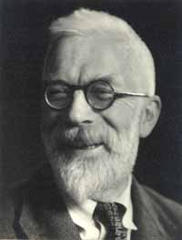
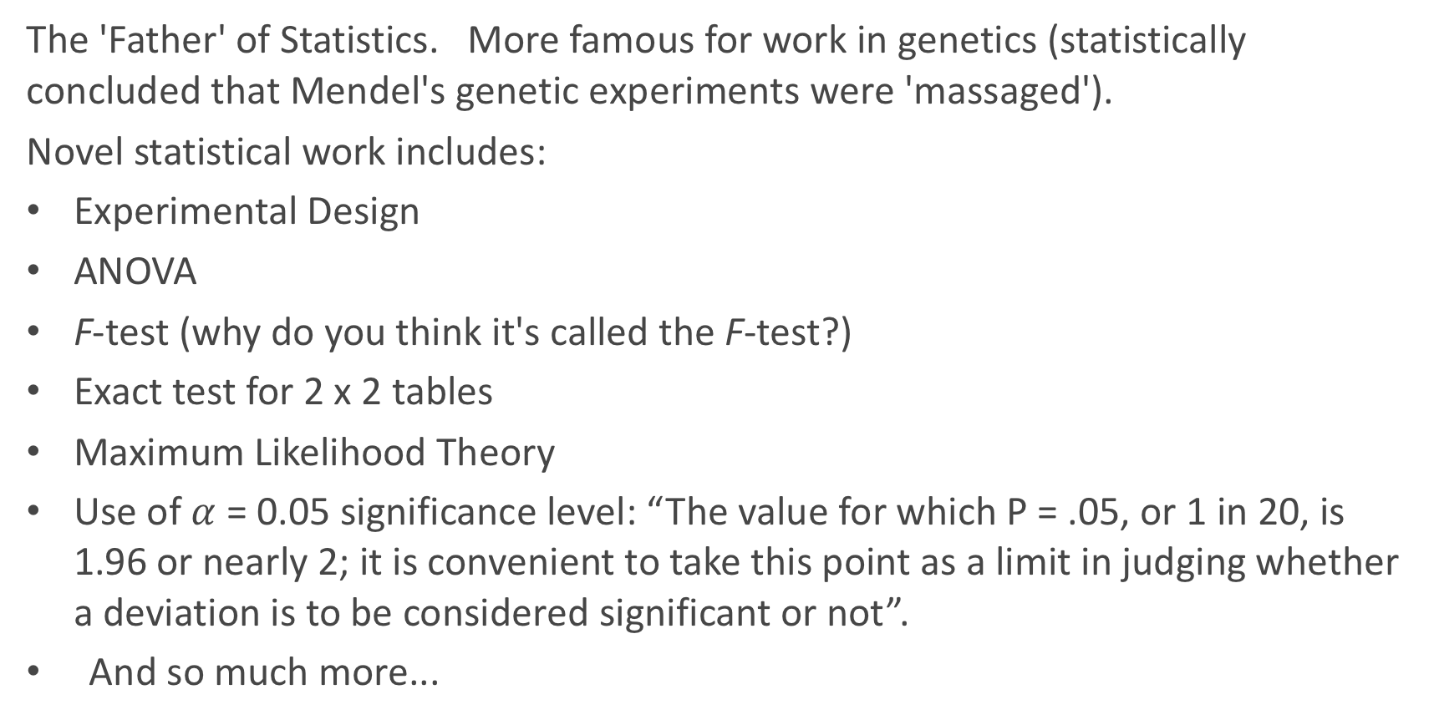
Inventor of LDA: R.A. Fisher
The 'Father' of Statistics. More famous for work in genetics (statistically concluded that Mendel's genetic experiments were 'massaged').
Novel statistical work includes:
Experimental Design
ANOVA
F-test (why do you think it's called the F-test?)
Exact test for 2 x 2 tables
Maximum Likelihood Theory
Use of $α$ = 0.05 significance level: “The value for which P = .05, or 1 in 20, is 1.96 or nearly 2; it is convenient to take this point as a limit in judging whether a deviation is to be considered significant or not”.
And so much more...

Slide 8
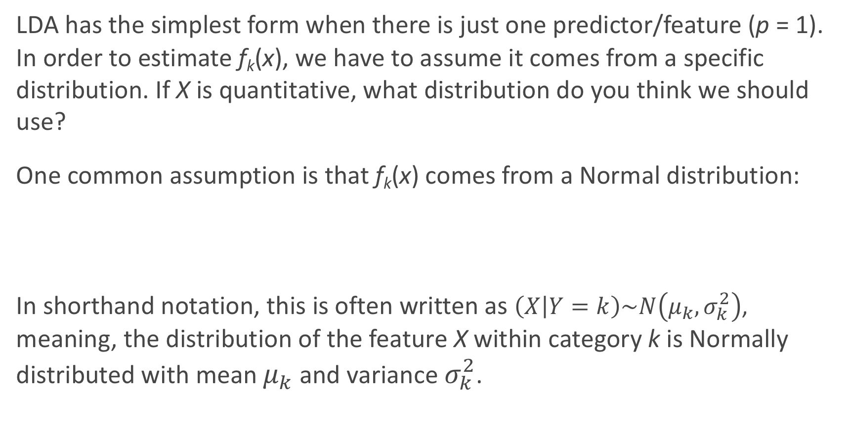
LDA for one predictor
LDA has the simplest form when there is just one predictor/feature (p = 1). In order to estimate f_{k}(x), we have to assume it comes from a specific distribution. If X is quantitative, what distribution do you think we should use?
One common assumption is that f_{k}(x) comes from a Normal distribution:
In shorthand notation, this is often written as $\left(X | Y=k\right)\sim N\left(μ_{k},σ_{k}^{2}\right)$, meaning, the distribution of the feature X within category k is Normally distributed with mean $μ_{k}$ and variance $σ_{k}^{2}$.

Slide 9
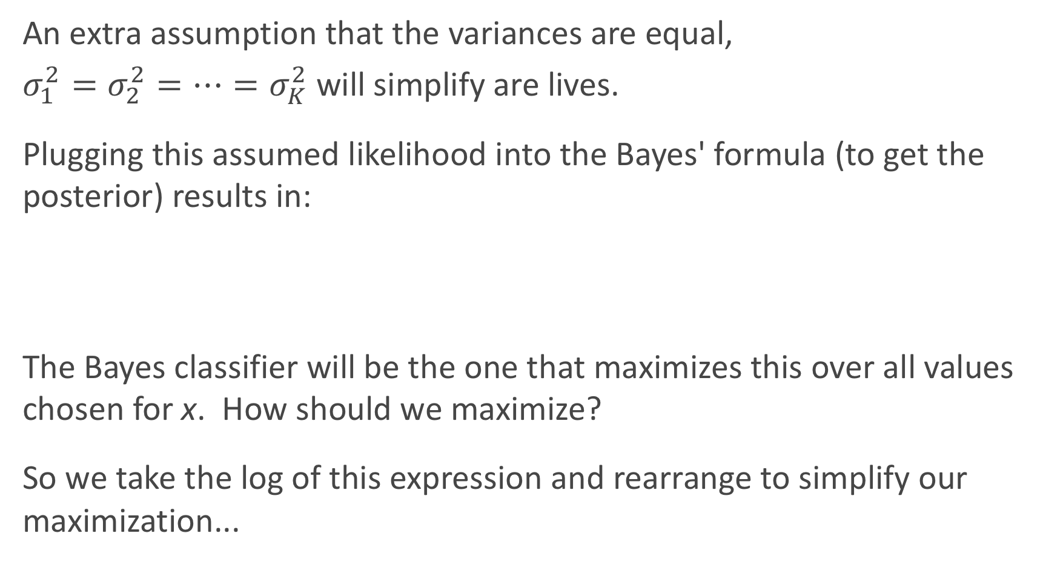
LDA for one predictor (cont.)
An extra assumption that the variances are equal,
$σ_{1}^{2}=σ_{2}^{2}=…=σ_{K}^{2}$ will simplify are lives.
Plugging this assumed likelihood into the Bayes' formula (to get the posterior) results in:
The Bayes classifier will be the one that maximizes this over all values chosen for x. How should we maximize?
So we take the log of this expression and rearrange to simplify our maximization...

Slide 10
LDA for one predictor (cont.)
So we maximize the following simplified expression:
How does this simplify if we have just two classes (K = 2) and if we set our prior probabilities to be equal?
This is equivalent to choosing a decision boundary for x for which
Intuitively, why does this expression make sense? What do we use in practice?

Slide 11
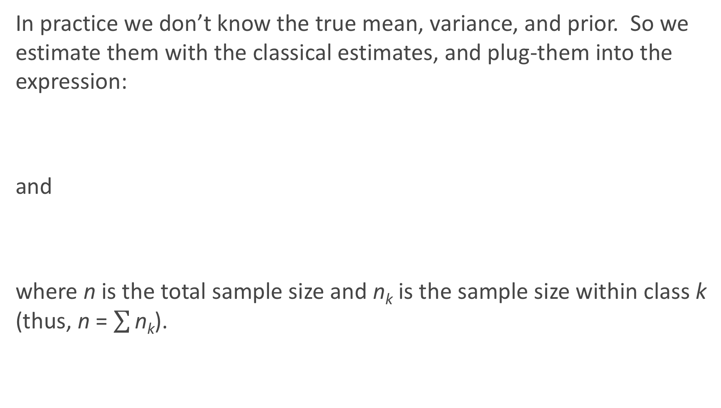
LDA for one predictor (cont.)
In practice we don’t know the true mean, variance, and prior. So we estimate them with the classical estimates, and plug-them into the expression:
and
where n is the total sample size and n_{k} is the sample size within class k (thus, n = $\sum{\text{n}\text{k}}$).

Slide 12
LDA for one predictor (cont.)
This classifier works great if the classes are about equal in proportion, but can easily be extended to unequal class sizes.
Instead of assuming all priors are equal, we instead set the priors to match the 'prevalence' in the data set:
Note: we can use a prior probability from knowledge of the subject as well; for example, if we expect the test set to have a different prevalence than the training set.
How could we do this in the Dem. vs. Rep. data set?

Slide 13
LDA for one predictor (cont.)
Plugging all of these estimates back into the original logged maximization formula we get:
Thus this classifier is called the linear discriminant classifier: this discriminant function is a linear function of x.

Slide 14
Illustration of LDA when p = 1
Notes:
Where the models flip is the boundary of the two.

Slide 15
LDA when p > 1

Slide 16
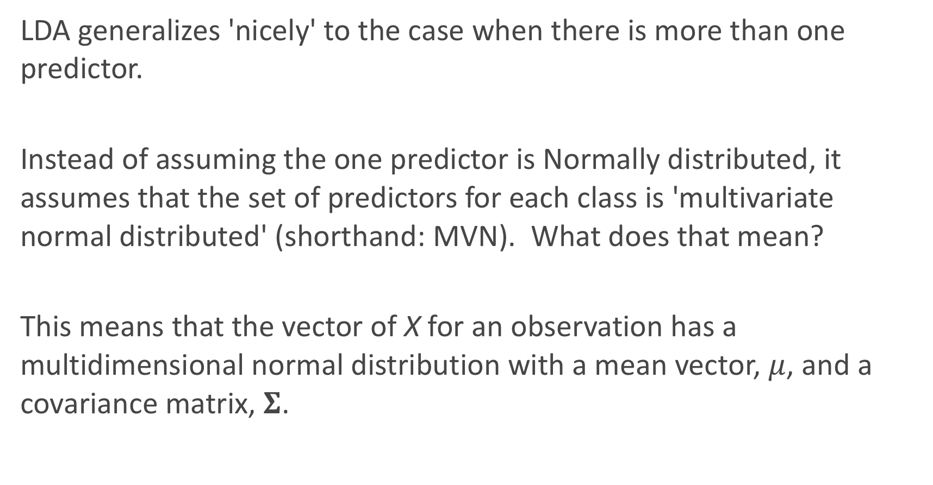
LDA when p > 1
LDA generalizes 'nicely' to the case when there is more than one predictor.
Instead of assuming the one predictor is Normally distributed, it assumes that the set of predictors for each class is 'multivariate normal distributed' (shorthand: MVN). What does that mean?
This means that the vector of X for an observation has a multidimensional normal distribution with a mean vector, $μ$, and a covariance matrix, $Σ$.

Slide 17
Multivariate Normal Distribution
Here is a visualization of the Multivariate Normal distribution with 2 variables:

Slide 18
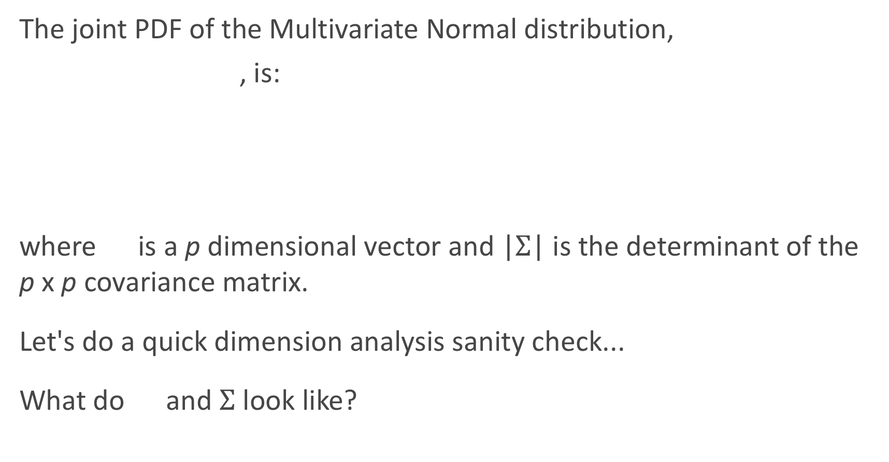
MVN Distribution
The joint PDF of the Multivariate Normal distribution,
, is:
where is a p dimensional vector and |$Σ$| is the determinant of the p x p covariance matrix.
Let's do a quick dimension analysis sanity check...
What do and $Σ$ look like?

Slide 19
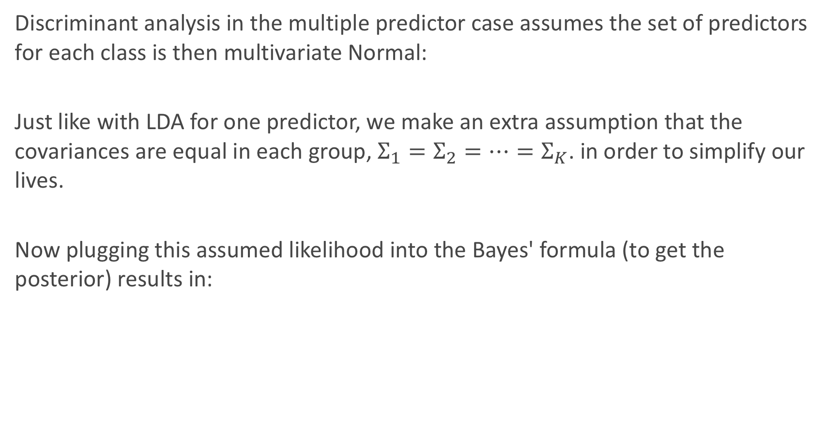
LDA when p > 1
Discriminant analysis in the multiple predictor case assumes the set of predictors for each class is then multivariate Normal:
Just like with LDA for one predictor, we make an extra assumption that the covariances are equal in each group, $Σ_{1}=Σ_{2}=…=Σ_{K}$. in order to simplify our lives.
Now plugging this assumed likelihood into the Bayes' formula (to get the posterior) results in:

Slide 20
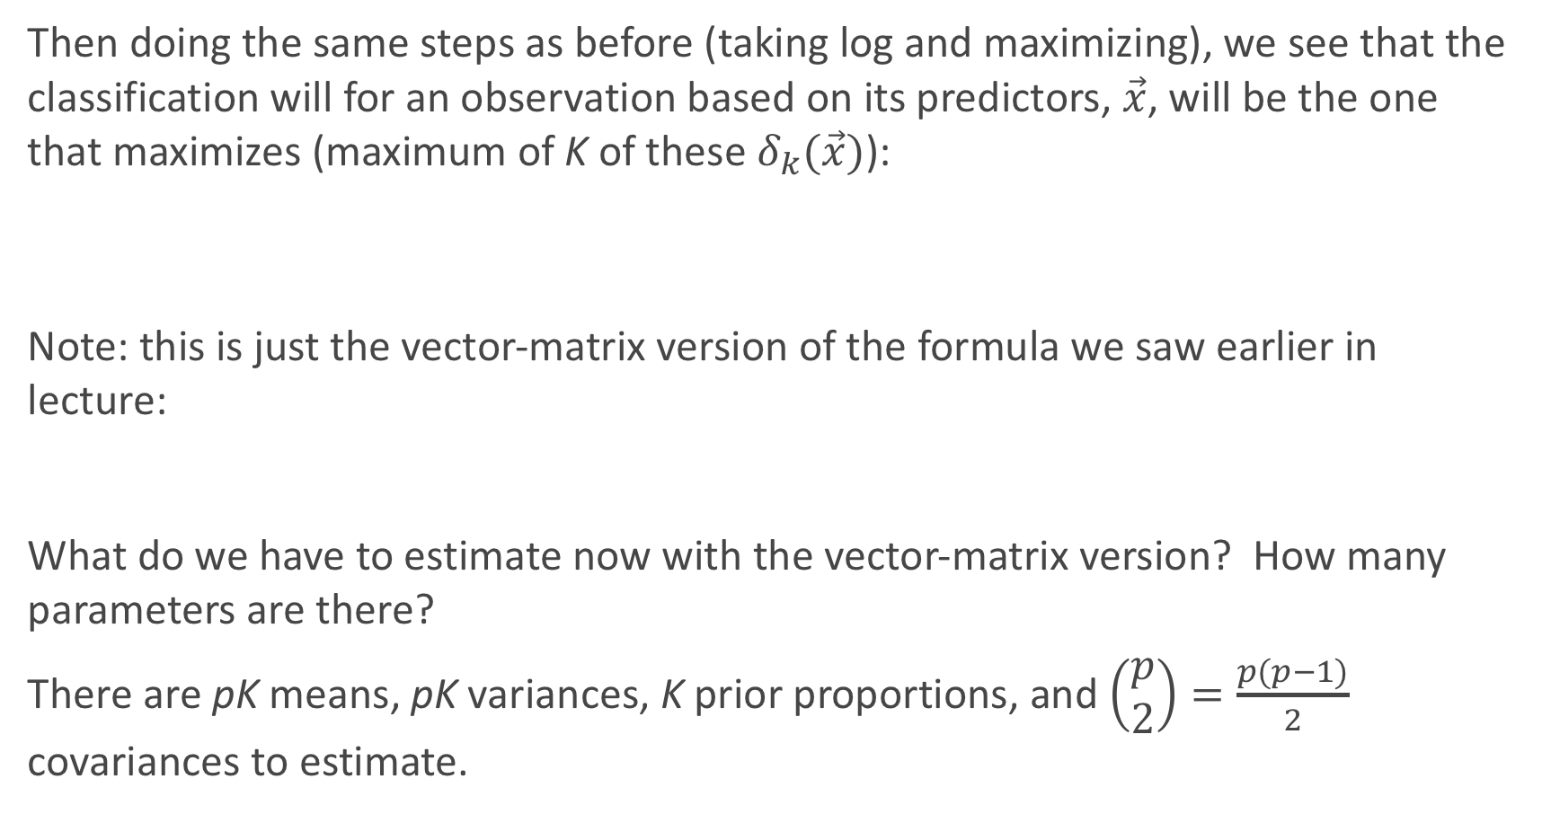
LDA when p > 1 (cont.)
Then doing the same steps as before (taking log and maximizing), we see that the classification will for an observation based on its predictors, $\vec{x}$, will be the one that maximizes (maximum of K of these $δ_{k}(\vec{x})$):
Note: this is just the vector-matrix version of the formula we saw earlier in lecture:
What do we have to estimate now with the vector-matrix version? How many parameters are there?
There are pK means, pK variances, K prior proportions, and $\left(\begin{matrix}p \\ 2\end{matrix}\right)=\frac{p(p−1)}{2}$ covariances to estimate.

Slide 21
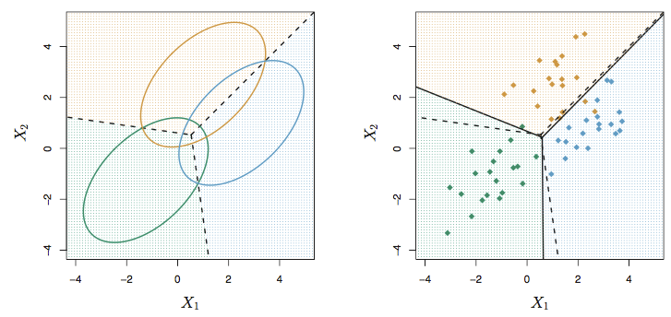
LDA when K > 2
The linear discriminant nature of LDA still holds not only when p > 1, but also when K > 2 for that matter as well. A picture can be very illustrative:

Slide 22
Quadratic Discriminant Analysis (QDA)

Slide 23
Quadratic Discriminant Analysis (QDA)
A generalization to linear discriminant analysis is quadratic discriminant analysis (QDA).
Why do you suppose the choice in name?
The implementation is just a slight variation on LDA. Instead of assuming the covariances of the MVN distributions within classes are equal, we instead allow them to be different.
This relaxation of an assumption completely changes the picture...

Slide 24
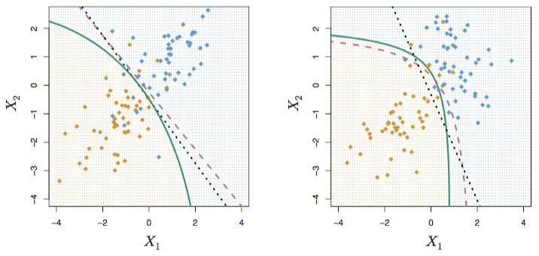
QDA in a picture
QDA in a picture
A picture can be very illustrative:

Slide 25
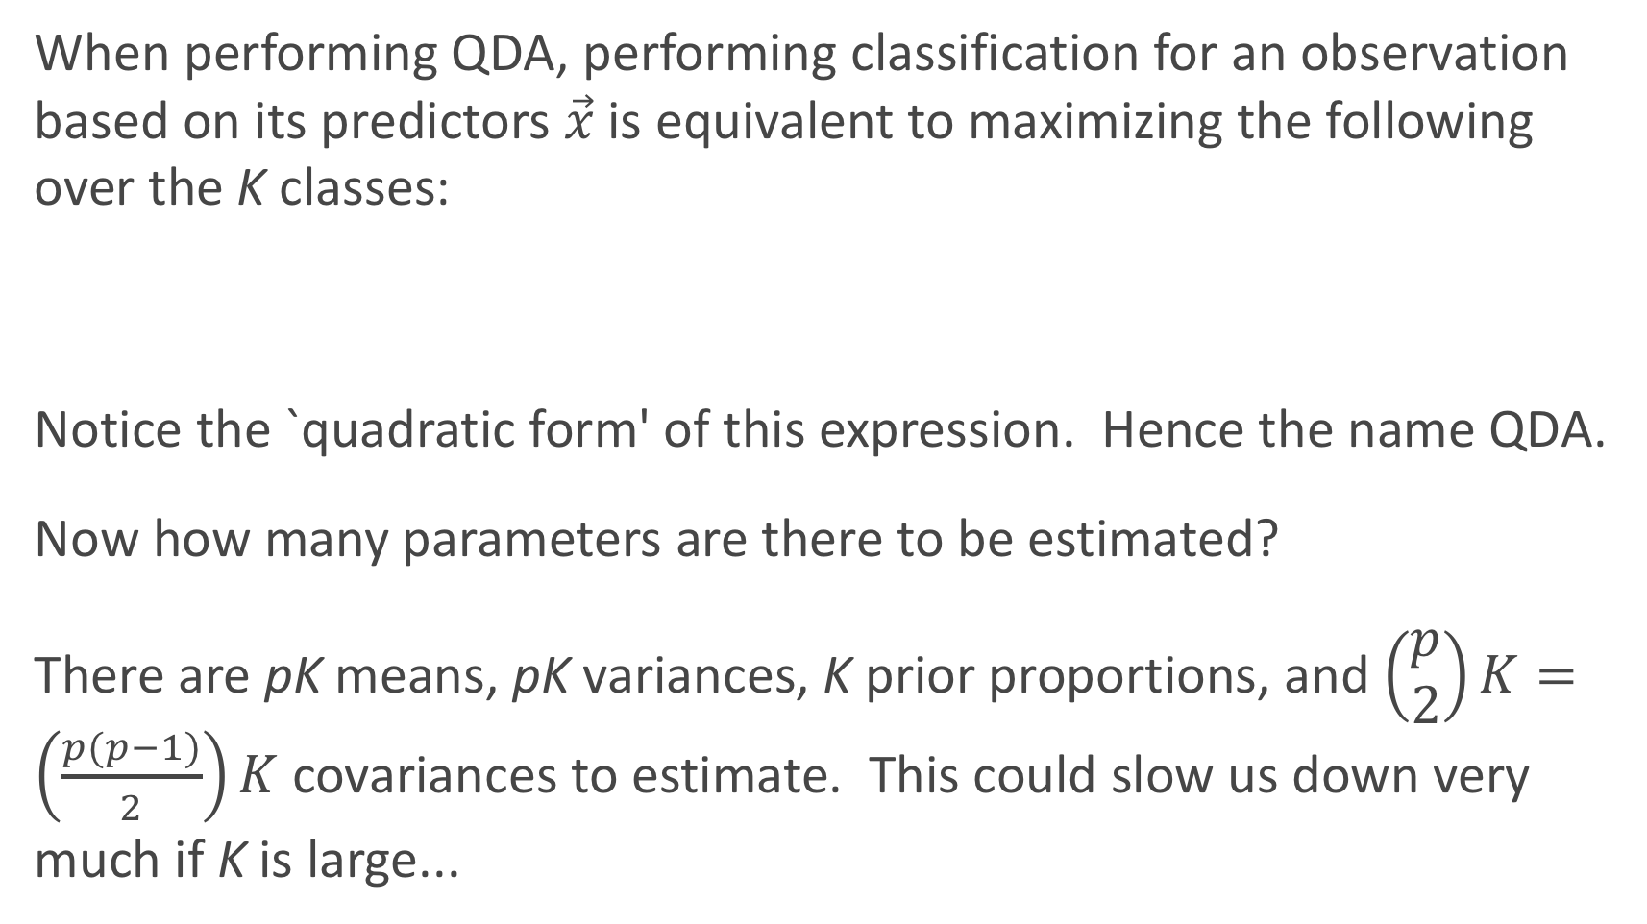
QDA (cont.)
When performing QDA, performing classification for an observation based on its predictors $\vec{x}$is equivalent to maximizing the following over the K classes:
Notice the `quadratic form' of this expression. Hence the name QDA.
Now how many parameters are there to be estimated?
There are pK means, pK variances, K prior proportions, and $\left(\begin{matrix}p \\ 2\end{matrix}\right)K=\left(\frac{p(p−1)}{2}\right)K$ covariances to estimate. This could slow us down very much if K is large...

Slide 26
Discriminant Analysis in Python
LDA is already implemented in Python via the sklearn.discriminant_analysis package through the LinearDiscriminantAnalysis function.
QDA is in the same package and is the QuadraticDiscriminantAnalysis function.
It's very easy to use. Let's see how this works

Slide 27
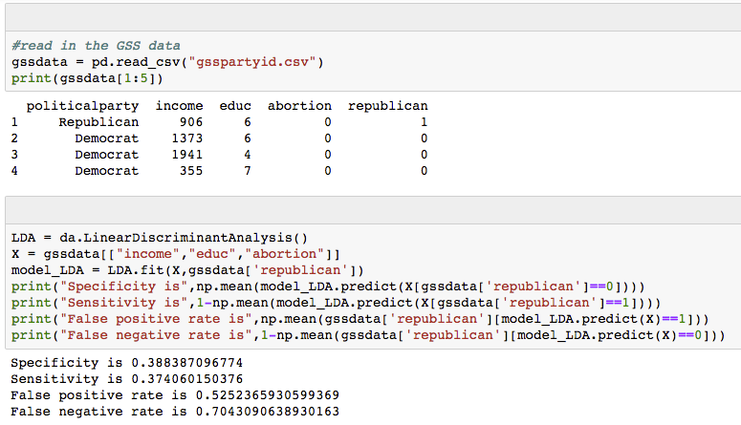
Discriminant Analysis in Python (cont.)

Slide 28
QDA vs. LDA
So both QDA and LDA take a similar approach to solving this classification problem: they use Bayes' rule to flip the conditional probability statement and assume observations within each class are multivariate Normal (MVN) distributed.
QDA differs in that it does not assume a common covariance across classes for these MVNs. What advantage does this have? What disadvantage does this have?

Slide 29
QDA vs. LDA (cont.)
So generally speaking, when should QDA be used over LDA? LDA over QDA?
The extra covariance parameters that need to be estimated in QDA not only slow us down, but also allow for another opportunity for overfitting. Thus if your training set is small, LDA should perform better for out-of-sample prediction, aka, predicting future observations (how do we mimic this process?)

Slide 30
Comparison of Classification Methods (so far)

Slide 31
Quadratic Discriminant Analysis (QDA)
We have seen 3 major methods for doing classification:
Logistic Regression
k-NN
Discriminant Analysis (LDA and QDA)
For a specific problem, which approach should be used?
Well of course, it depends on the nature of the data. So how should we decide?
Visualize the data!
Notes:
Logistic regression is the best for classification
KNN is the slowest, while regression is the fastest. LDA when you have large quantity of data and not necessarily need a predictive model.

Slide 32
Six Classification Models We'll Compare
Let's investigate which method will work the best (as measured by lowest overall classification error rate), by considering 6 different models for 4 different data sets (each data set as a pair of predictors...you can think of them as the first 2 PCA components…to come later in the lecture). The 6 models to consider are:
A logistic regression with only 'linear' main effects}
A logistic regression with only 'linear' and 'quadratic' effects}
LDA
QDA
k-NN where k = 3
k-NN where k = 25
What else will also be important to measure (besides error rate)?

Slide 33
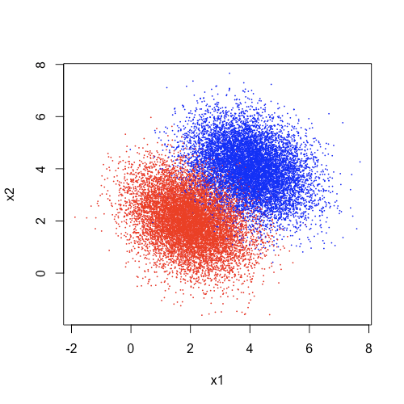
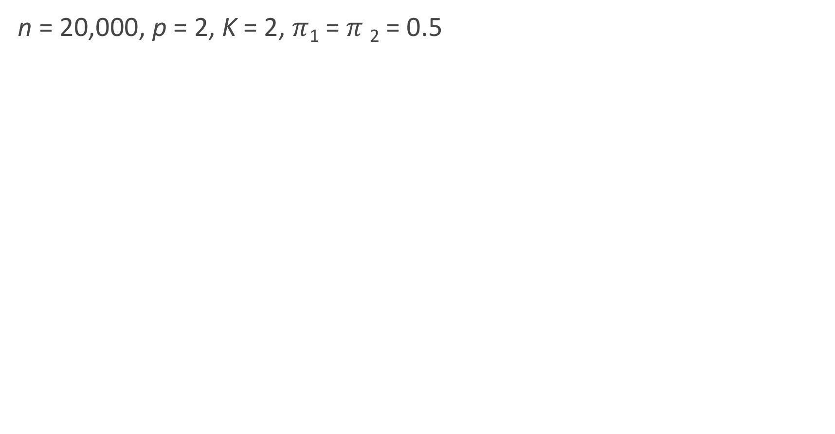
Which method should perform better? #1
n = 20,000, p = 2, K = 2, $π$₁ = $π$₂ = 0.5
Notice anything fishy about our answers? What did Kevin do? What should he have done?
Notes:
Because we follow the
Linear logistic regression is probably the best to take.
QDA is the fastest.
KNN is the worst to fit by only a little a bit. Fine to use either model to do the classification.

Slide 34
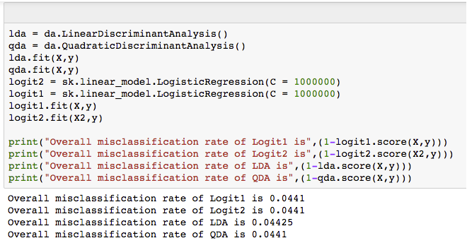
Easy to implement in Python

Slide 35
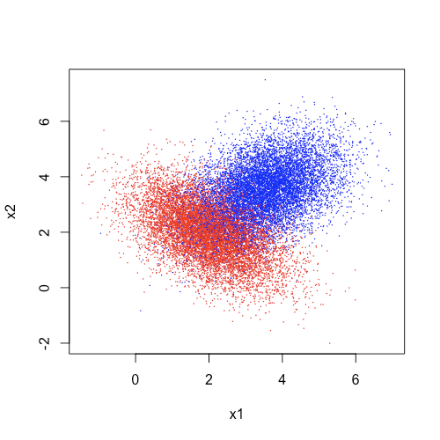
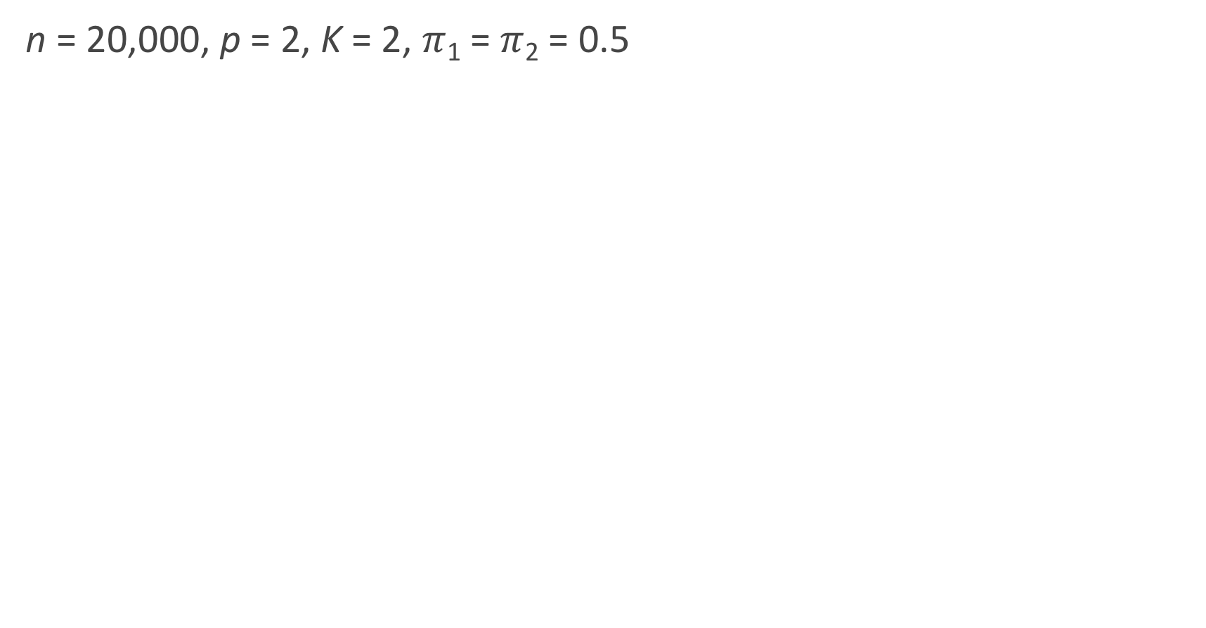
Which method should perform better? #2
n = 20,000, p = 2, K = 2, $π$₁ = $π$₂ = 0.5
Notes:
Is that improvement worthwhile?

Slide 36
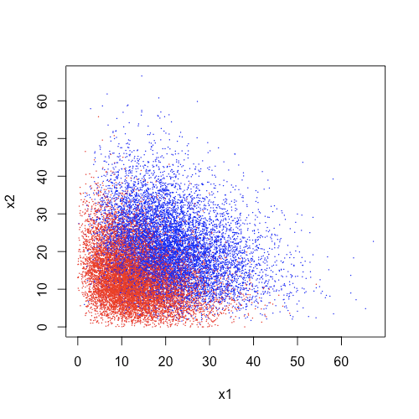
Which method should perform better? #3
n = 20,000, p = 2, K = 2, $π$₁ = $π$₂ = 0.5
Notes:
CURVE
QDA > LDA
Logistics > discriminated analysis

Slide 37
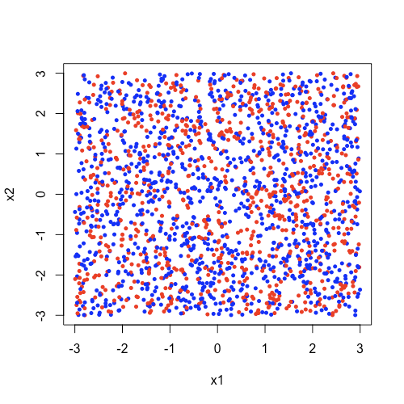
Which method should perform better? #4
n = 20,000, p = 2, K = 2, $π$₁ = $π$₂ = 0.5

Slide 38
Summary of Results
Generally speaking:
LDA outperforms Logistic Regression if the distribution of predictors is reasonably MVN (with constant covariance).
QDA outperforms LDA if the covariances are not the same in the groups.
k-NN outperforms the others if the decision boundary is extremely non-linear.
Of course, we can always adapt our models (logistic and LDA/QDA) to include polynomial terms, interaction terms, etc... to improve classification (watch out for overfitting!)
In order of computational speed (generally speaking, it depends on K, p, and n of course):
LDA > QDA > Logistic > k-NN

